Slide 1
RISC-V
Group 5
Jake, Ben, Drew, Jessica, Daniel

Slide 2
RISC Processor-History(Jake 1/5)
Reduced Instruction Set Computer (RISC, pronounced RISK) is a type of Instruction set architecture (ISA) focusing on creating an instruction set that requires a limited number of processor cycles to execute a single instruction
Although a number of computers from the 1960’s and 1970’s have been identified as forerunners of RISC, modern concepts of RISC date back to 1980s as a reaction to the standard Complex Instruction Set Computers (CISC)
RISC chips break down the complex instructions into many small steps however, many more instructions are needed to accomplish the same task as a CISC ISA, remember it is about reducing the complexity of the instructions not the amount of instructions as the name suggests

Slide 3
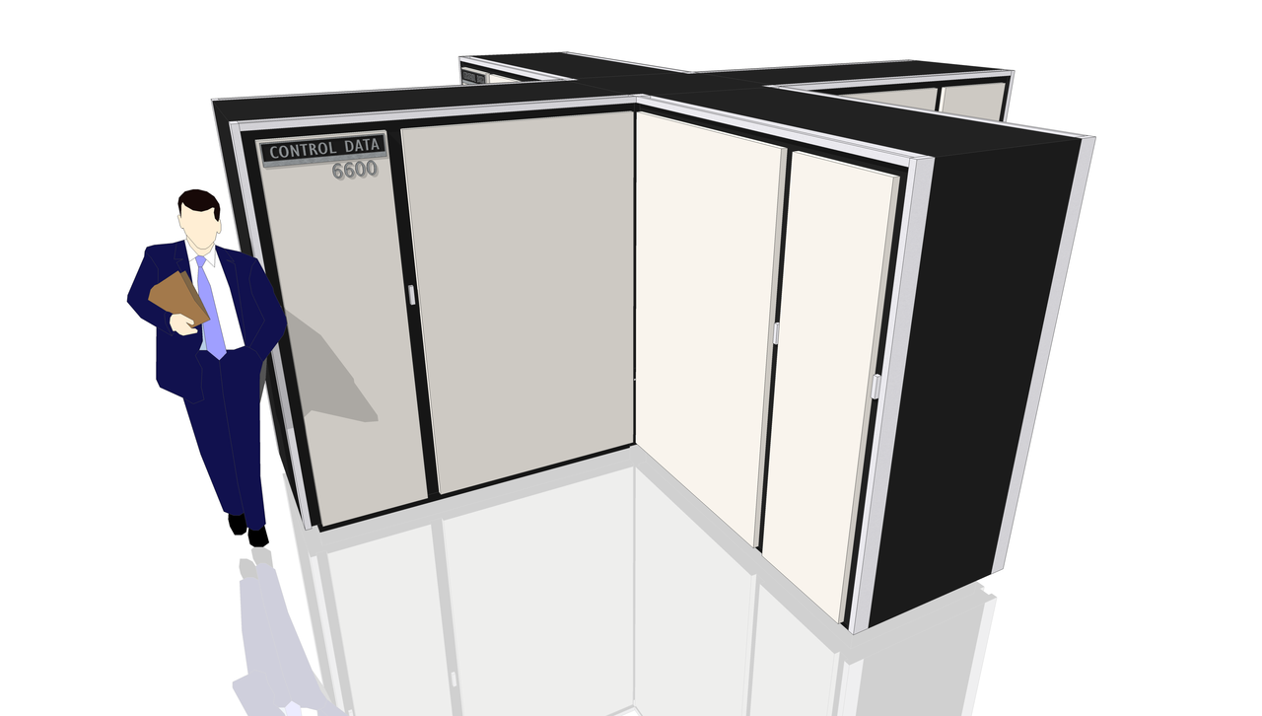
RISC Processor-History(Jake 2/5)
CDC 6600 designed by Seymour Cray
Forerunner of what we know now as RISC
Fastest computer from 1964-1969
Price was $2,370,000.00(19,540,000 in 2019)
Previous to this a processor might take 15 cycles
to multiply two numbers, while each memory
access took one to two cycles. This meant
significant time main memory was idle.
The 6600 exploited this fact by completing the
Multiplication in 10 cycles

Slide 4
RISC Processor-History(Jake 2/5)
What made the CDC 6600 very unique at the time were the functional units and scoreboard
Execution unit directed instructions to the appropriate function unit (load/store/arithmetic)
Scoreboard kept track of what registers were in use
Allowed for multiple instructions to be executed at once

Slide 5
RISC Processor-History(Jake 3/5)
The idea is that many of the CISC complex instructions are not utilized fully and many programmers use compilers that don’t use complex instructions because of differences in computer languages
RISC processors have a clock per instruction (CPI) of one cycle due to the optimization of each instruction on the CPU using pipelining
Allows for simultaneous execution of parts, or stages, of instructions to more efficiently process instructions
The RISC design philosophy generally incorporates a larger number of registers to prevent large amounts of interactions with memory
RISC need fewer transistors making them cheaper and easier to design

Slide 6
RISC Processor-History(Jake 4/5)
RISC vs CISC example instruction
CISC: Multiply-Complex instruction
MUL Val1, Val2
RISC: Multiply-Simple Instruction
Load A, 2
Load B, 5
PROD A, B
STORE C, 10
Advantages- Pipelining, Operand remains in register for future use, less transistors needed so more room for general purpose registers

Slide 7
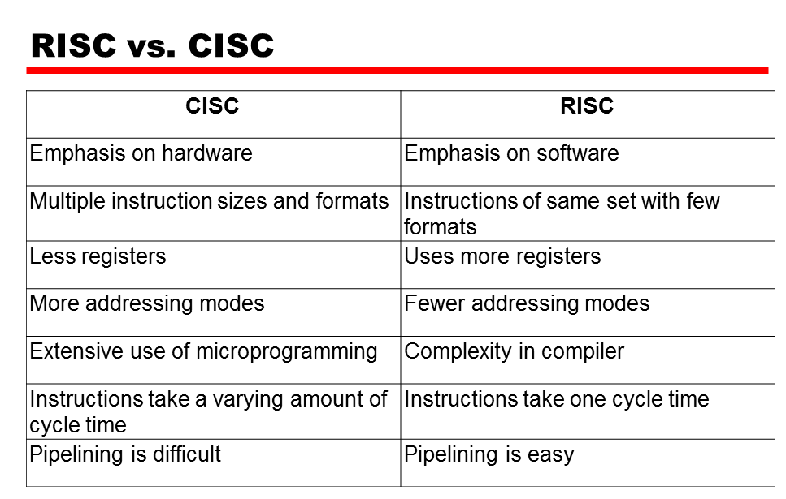
RISC-V Processor-History(Jake 5/5)

Slide 8
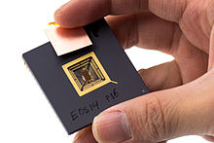
RISC-V Processor-History(Jake 1/4)
RISC-V (Pronounced RISK-FIVE) is the latest in RISC development
RISC-V Started at UC Berkeley in May 2010
Kirste Asanovic saw many uses for an open source computer system
David Patterson originally identified the Berkeley RISC and cooperatively RISC-V is the latest
Started with a goal to make a practical ISA that was open-sourced
Free to download and use by anyone and free to customize as user sees fit
RISC-V Designers wanted open source to increase development and design from multiple collaborative efforts
RISC-V Prototype Jan,2013 -->

Slide 9
RISC-V Processor-History(Jake 2/4)
After the invention of RISC-V, many entities started using it
Previous to this the United States Air Force developed the open standard MIL-STD-1750 16-bit processor ISA for military applications for security and development
The Defense Advanced Research Projects Agency (DARPA) started using RISC-V because of it’s open architecture design. It allowed them to inspect and analyze the ISA to assess security and where it needed to be improved preemptively instead of having security algorithms added after breaches were identified in previous ISA implementation
This provided great benefits to U.S. taxpayers in reducing the cost of advanced military system development allowing the government to build their own trusted implementations at a low cost

Slide 10
RISC-V Processor-History(Jake 3/4)
Commercial users require an ISA to be stable before they use it in their product
RISC-V international foundation was formed to own maintain and publish intellectual property and the original authors and owners gave up their rights to the foundation
As of 2019, RISC-V international freely publishes documents defining RISC-V and permits unrestricted use of the ISA for design of software and hardware but, only members who have paid for a membership can vote on changes and participate in development discussions
Implementation is currently expanding rapidly

Slide 11
RISC-V Processor-History(Jake 4/4)
References
https://riscv.org/
https://cs.stanford.edu/people/eroberts/courses/soco/projects/risc/risccisc/
https://en.wikipedia.org/wiki/Reduced_instruction_set_computer
https://en.wikipedia.org/wiki/RISC-V
https://github.com/riscv
https://cacm.acm.org/magazines/2020/5/244325-will-risc-v-revolutionize-computing/fulltext

Slide 12
RISC-V Manufacturing
TSMC is doing the fab for most large scale implementations of RISC-V.
Western Digital (WD) is getting a new set of research servers from SiFive that use the RISC-V architecture.
This is really more of a test so that WD can sell data storage server turnkey solutions to other companies and use the advantages of RISC-V in this configuration, allowing much more efficient access and use of large (petabytes or more) amounts of data.
Alibaba is doing something similar in-house.
Alibaba has a huge amount of commercial shopping data that they want to retain and use.
This makes a lot of sense due to the relatively barebones nature of the base RISC-V ISA.
For a long time many thought RISC-V would not take off in the business space and would remain an experiment for students to tinker with at universities, however these two major investments in the last 2 years are a promising sign for the future of RISC-V.
There are some mobile implementations but I chose to focus on its modern use in servers for this presentation

Slide 13
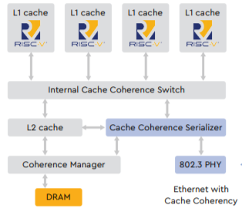
RISC-V Caching
There are many implementations of RISC-V because it is open source so the following slides will look at some specific implementations, but this ISA is commonly modded to fit a certain role and often this means changing parts of the hyperthreading, caching and core management. Do not consider this a complete list of arrangements of hardware that runs RISC-V.
Here the WD implementation of cache in their RISC-V processor:
It shows several chips with their L1 on the chip itself.
Then the L2 cache on the same die.
Then finally it goes out to RAM and other networked I/O (ethernet).

Slide 14
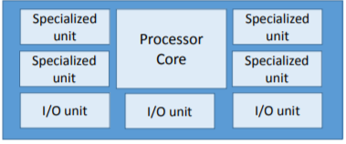
RISC-V Threading
Threading in RISC-V is usually conducted to connect a main processor (or processors) to a specific hardware chips like hardware video encoding or hardware for zipping and unzipping files.
These are usually in the form of SOCs (systems on a chip) and use the low instruction set nature of base versions of RISC-V to make a very low power processor that can be used in IoT applications.

Slide 15
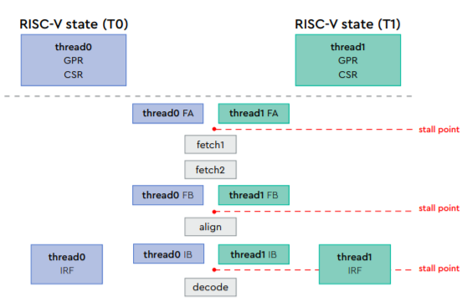
RISC-V Cores
WD has created what it calls SweRV Core
This core is very power efficient and has been optimized for working with flash memory and memory arrays
Most RISC-V cores are sinlge thread but some new core arrangements are multithreaded, this creates even more power efficiency as most software will see this as ‘2 cores’ instead of one SMT core
These arrangements are very useful for high I/O operations (like flash controllers and raid controllers)

Slide 16
CPU Management - Paging
RISC-V uses a system known as Paging
Used by a piece of hardware (known as an MMU or Memory Management Unit) that translates from virtual to physical addresses
translates virtual addresses into physical addresses, this is performed by a privileged register called SATP or Supervisor Address Translation and Protection register
SATP turns the MMU on or off, sets the address space identifier and the physical memory address where the first page tables are found
3 parts to it; virtual address, physical address, and page table entry

Slide 17
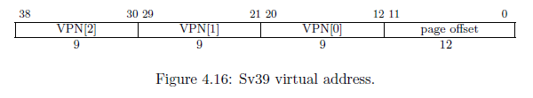
Virtual Memory
has a few different modes Sv32, Sv48, and Sv39
each table entry is 8-byte
contains VPN[x] (Virtual page number) which is an index into an array of the number of 8-byte entries the mode has. Ex) Sv39 has 512 entries
Doesn’t translate virtual address directly into a physical address but goes through a series of tables instead

Slide 18
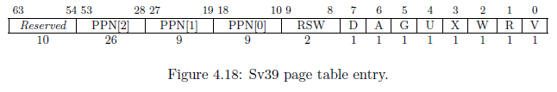
Tables
tables can be placed anywhere in ram as long as the last 12 bits are 0
to get the actual memory address the 44bits from SATP are taken and shifted left 12 to replace those 0s, end up with a 56-bit bit address.
a table entry is written by the OS to control how the MMU works
can change how an address is translated or set certain bits to protect a page

Slide 19
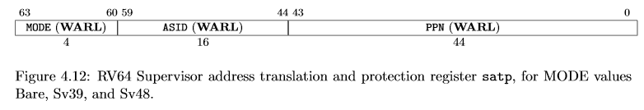
Physical Address
Physical address is 56-bits, the virtual address is translated, by the SATP, into a 56-bit physical one
allows mapping the same virtual address to different physical ones
physical address is the PPN, which is a 44-bit value, divided by however many bits it was shifted before being stored.
the image shows a PPN that has been shifted 12 bits, the actual number is divided by 2^12 making the PPN 12.

Slide 20
Page Faults
-There are 3 page faults, these are used by the MMU to tell the CPU an error has occurred
-The three types are:
Instruction
Load
Store
Faults are trapped by the CPU and the mcause or scause register will contain 12, 13 or 15 for instruction, load and store page faults respectively

Slide 21
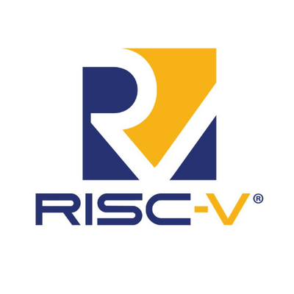
Instruction Set Architecture (ISA) - Drew
Overview of RISC-V ISA with a focus on:
Registers
Stack Management
Sample Instructions

Slide 22
Instruction Set Architecture (ISA) - Drew
The ISA type is broken into 3 parts:
RV (RISC 5) N (address width) L (extension letter)
RV32E, RV32I, RV64I, and RV128I are the base ISA’s.
I (integer), E (embedded)
M: Math, A: Atomic ops, F: Floating point, D: Double Precision FP are the standard extensions with G containing all at of them at once.
G: General purpose (I, M, A, F, D)

Slide 23
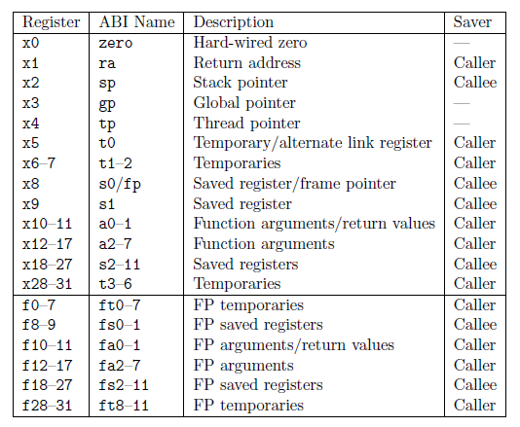
Registers - Drew
RV32I: RISC V 32-bit Integer ISA
32 registers: x0 - x31
Registers are 32-bits wide
(Known as 1 word)
Apart from x0, none of these are
set in stone but there is no reason
not to use them this way.

Slide 24
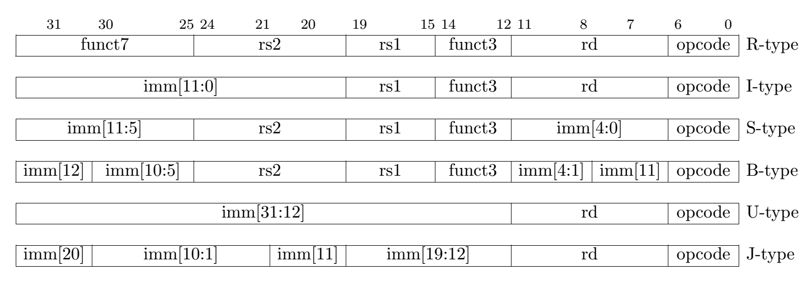
Instruction Formats - Drew
In RV32I there are 47 instructions, which can be grouped into six types:
R-type: register-register
I-type: short immediates and loads
S-type: stores
B-type: conditional branches, a variation of S-type
U-type: long immediates
J-type: unconditional jumps, a variation of U-type

Slide 25
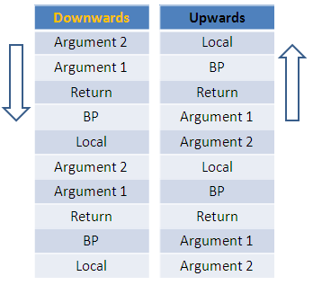
Stack Management - Drew
The stack grows downward and the stack
pointer is always kept 16-byte aligned.
Subroutines must be called one at a time
through the stack. RISC-V has no save
multiple or restore multiple register
instructions. This makes up the majority
of the static code and slows down the CPU.

Slide 26
Stack Management - Drew
The stack-pointer-based compressed loads and stores in RVC are effective at reducing the save/restore static code size by a factor of 2 while improving performance by reducing dynamic instruction bandwidth. This also takes up a large part of the static code.
Any x register can be used but almost all users stick to the table above. Several key parts of the code work on the assumption that the table being used.

Slide 27
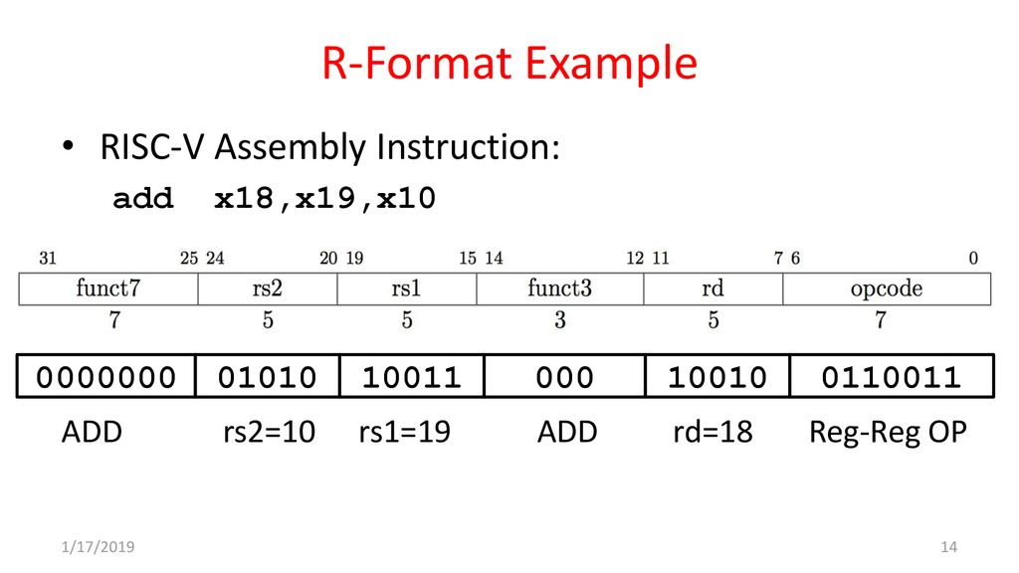
Sample instructions - Drew
Similar to assembly, RISC V instructions follow some variation of:
Add rd, rs1, rs2
Add: Opcode
rd: Destination register
rs1: Source register 1
rs2: Source register 2

Slide 28
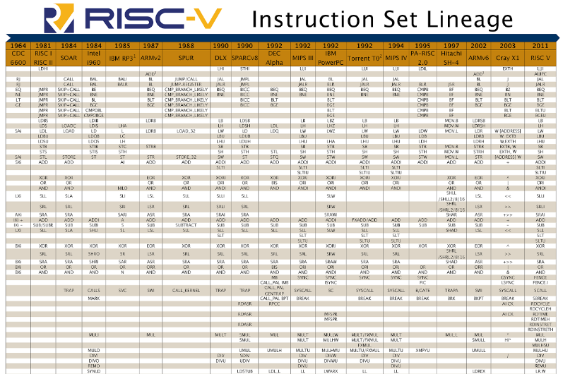
Prelude to Sample Program: RISC-V Genealogy (Daniel)
From : https://riscv.org/wp-content/uploads/2016/02/EECS-2016-6.pdf , a paper on the progression of the ISA of RISC systems starting all the way back with the CDC 6600 in 1964 to the present day RISC-V implementation. This is only part of the picture, as the full table was too large to fit in a slide. I encourage anyone interested to view the link provided because the paper is well written and has an extensive bibliography.

Slide 29
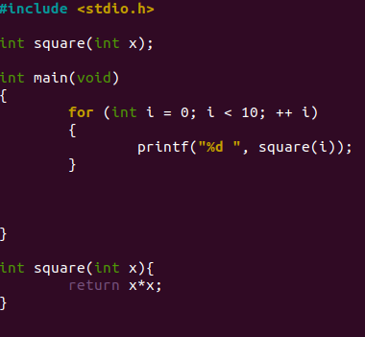
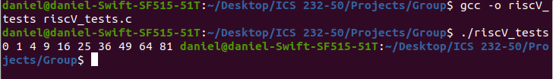
Sample Program #1
A very simple c program with a very simple output.

Slide 30
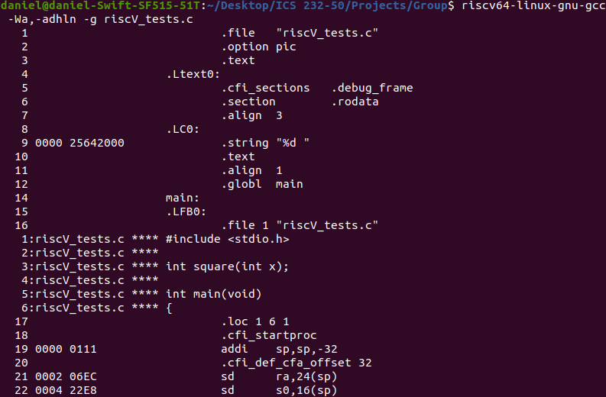
Program #1 Compiled in RISC-V: Unoptimized
There are two types of commands that begin with a period: labels (specifically functions created during compilation) and assembler directives. Assembler directives are commands that are not part of the instruction set, but are used for formatting purposes (thus the .align command), or other special purposes that fall outside of the instruction set. You can think of them as “meta instructions”.
Let’s exclude the assembler directives and address information for clearer viewing.

Slide 31
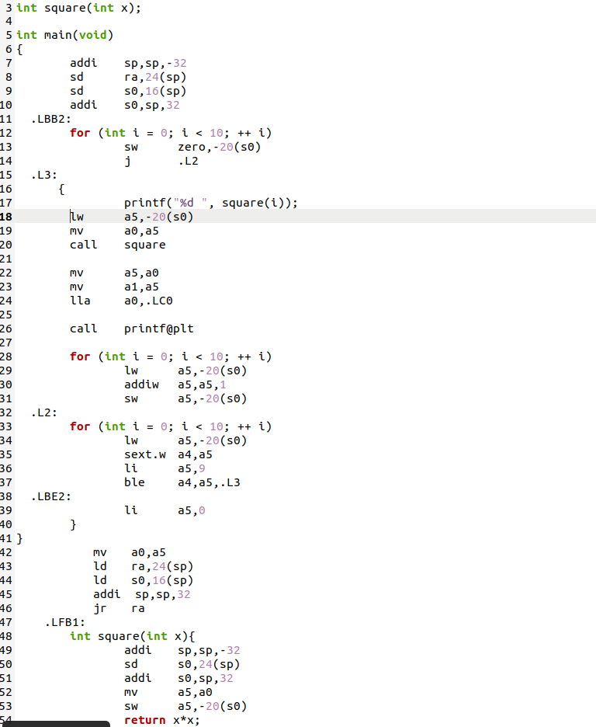
Program #1: Unoptimized with Extras Removed
Our program is still somewhat recognizable, retaining much of the basic structure of the c code. However, labels have been added and the c code has been expanded into assembly.
lw (load word) loads a 32 bit value and sign-extends it to 64 bits before storing it in a register.
On line 22 for example, data in a0 is being copied into a5.
addi: line 51, adds the value of sp to -32 and stores the result back into sp. Stands for “add immediate”. This is part of stack management, and line 51 is actually allocating 32 bytes of memory for use.
The reason .L3 is included as an argument for ble on line 37 is that ble is a branching instruction, specifically an “if less than or equals to” branching.

Slide 32
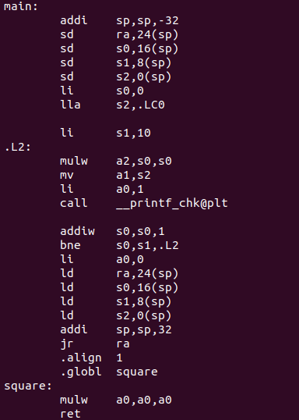
Program #1 in RISC-V: Optimized Version
The optimized version is unrecognizable from our original code in C, but is far superior in terms of efficiency. The addi operation at the very top is grabbing the number of bytes needed to store 4 register values (8 bytes each), and then storing our values in registers using the allocated bytes.
Our optimized code only has three functions when assembly directives are excluded.
The command sp stands for stack pointer. You can think of sd (store double word) as push, and ld (load) as the pop.
According to Stephen Marz, professor at UTK (see sources), “... all functions have a preamble, which is essentially setting up a stack frame for local storage, and an epilogue, which usually entails loading saved registers and return address and moving the stack pointer before returning.”
When applied to our program, main is the preamble, and .L2 is the epilogue.

Slide 33
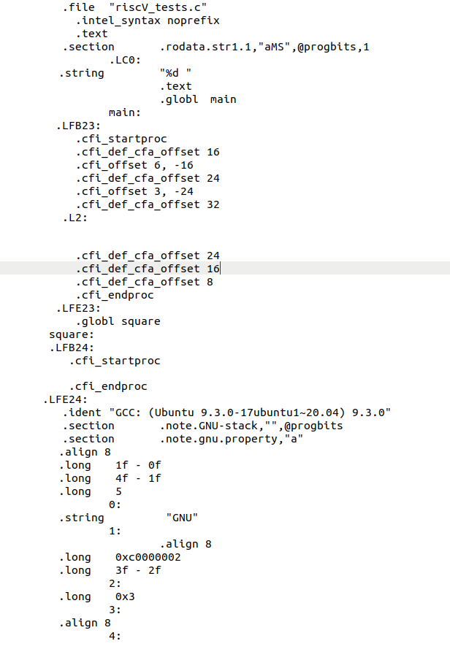
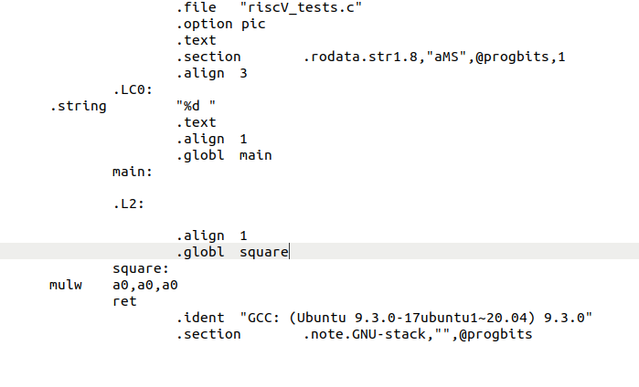
Working the assembler; RISC-V vs x86 Optimized

Slide 34
Sources Ordered by Prominence: Most to Least (Daniel)
https://riscv.org//wp-content/uploads/2017/05/riscv-spec-v2.2.pdf
https://web.eecs.utk.edu/~smarz1/courses/ece356/notes/assembly/
https://metalcode.eu/2019-12-06-rv32i.html
https://docs.oracle.com/cd/E36784_01/html/E36859/eoiyg.html
https://riscv.org/wp-content/uploads/2016/02/EECS-2016-6.pdf
https://github.com/riscv/riscv-asm-manual/blob/master/riscv-asm.md
https://passlab.github.io/CSCE513/notes/lecture04_RISCV_ISA.pdf
https://stackoverflow.com/questions/24787769/what-are-lfb-lbb-lbe-lvl-loc-in-the-compiler-generated-assembly-code
https://stackoverflow.com/questions/56874101/how-does-risc-v-variable-length-of-instruction-work-in-detail

